Slide 1
Network Layer/IP Protocols

Slide 2
Outline
IP Datagram (IPv4)
NAT
Connection less and connection oriented service

Slide 3
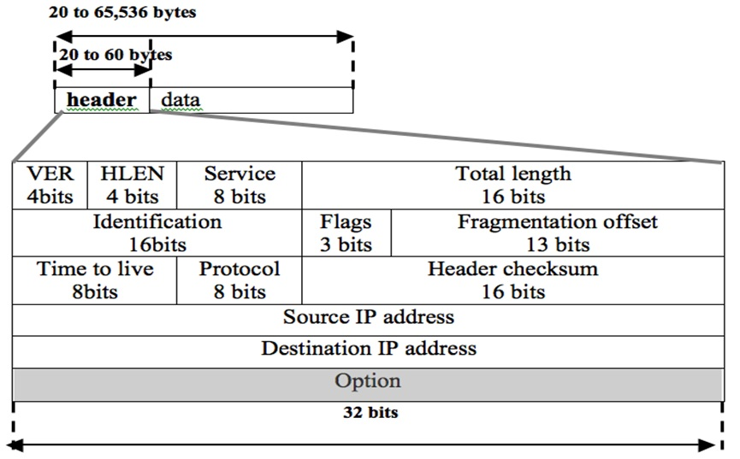
IPv4 Packet Header

Slide 4
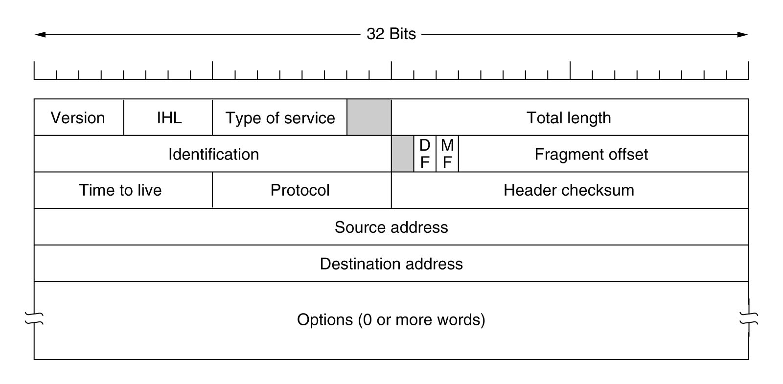
IPv4 Datagram Header Format
version of the IP protocol (4 BIts)
IP header length (4 Bits)
Low Delay, High Throughput, Reliability (8 Bits)
length of header + payload (16 Bits)
Specified in terms of “no of 8 bytes” (13 Bits)
Unique packet id (16 Bits)
“do not fragment” (FLAG)
“more fragments” (FLAG)

Slide 5
IPv4 Datagram Header Format
Helps to limit the no. of hops or time spent in the network (8 Bits)
Protocol name (TCP, UDP etc.) to whom pass the payload (8 Bits)
16 bit checksum, covers header only
Source IP address
Optional information, such as source route
Destination IP address
Due to OPTIONS, the datagram header can be of variable length. So, one can not determine apriori where the data will start.
Thus, unpredictable time to process the IP datagram. Hence, OPTIONS dropped in IPv6

Slide 6
IP Fragmentation
Fragmentation is used in a case when a router receives a protocol data unit (PDU) larger than the next hop's MTU(Maximum Transmission Unit).
  MTU: Maximum amount of data that a Link-Layer frame can carry.
Each IP datagram is supposed to be encapsulated within the link-layer frame for transportation from one router to other.
MTU sets the limit on length of an IP datagram. Also, along the given path:
Different routers/links → Different link layer protocols→ Different MTU (A PROBLEM)
SOLUTION: It has either of two options if the transport is IPv4:
    Drop the PDU and send an Internet Control Message Protocol(ICMP) message which indicates the condition Packet too Big.
    Fragment the IP packet and send it over the link with a smaller MTU.
The Identification field, and Fragment offset field along with Don't Fragment & More Fragment flags in the IP protocol header are used for fragmentation and reassembly of IP datagram.

Slide 7
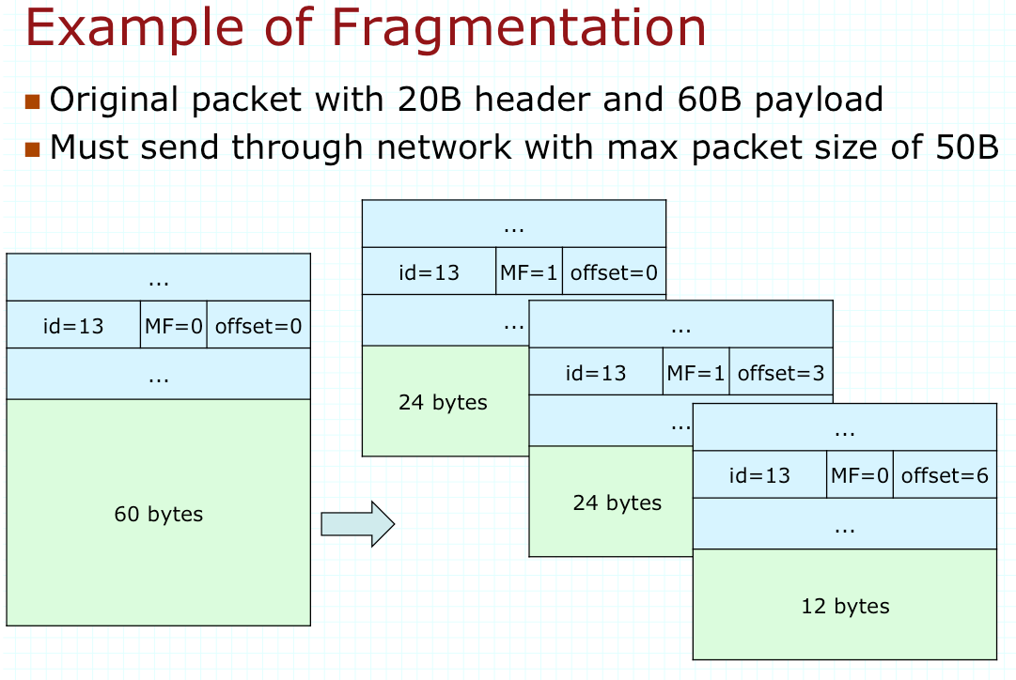

Slide 8
IP Addressing

Slide 9
IP Addressing
An IP address is a 32-bit address
The IP addresses are unique.
The address space of IPv4 is 2³² or 4,294,967,296.

Slide 10
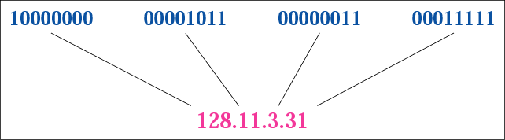
Dotted-decimal notation

Slide 11
Hexadecimal Notation
0111 0101 1001 0101 0001 1101 1110 1010
75 95 1D EA
0x75951DEA

Slide 12
Example 1
Change the following IP address from binary notation to dotted-decimal notation.
10000001 00001011 00001011 11101111
Solution
129.11.11.239

Slide 13
Example 2
Change the following IP address from dotted-decimal notation to binary notation.
111.56.45.78
Solution
01101111 00111000 00101101 01001110

Slide 14
Example 3
Find the error, if any, in the following IP address:
111.56.045.78
Solution
There are no leading zeroes in dotted-decimal notation (045).

Slide 15
Example 3 (continued)
Find the error, if any, in the following IP address:
75.45.301.14
Solution
In dotted-decimal notation, each number is less than or equal to 255; 301 is outside this range.

Slide 16
CLASSFUL ADDRESSING

Slide 17
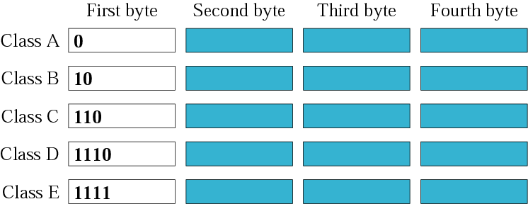
Finding the class in binary notation
2³¹
2³⁰
2²⁹
2²⁸
2²⁸

Slide 18
Example 6
Find the class of the address:
00000001 00001011 00001011 11101111
Solution
The first bit is 0.
This is a class A address.

Slide 19
Example 6 (Continued)
Find the class of the address:
11000001 10000011 00011011 11111111
Solution
The first 2 bits are 1; the third bit is 0.
This is a class C address.

Slide 20

Finding the class in decimal notation

Slide 21
Example 7
Find the class of the address:
227.12.14.87
Solution
The first byte is 227 (between 224 and 239);
The class is D.

Slide 22
Example 7 (Continued)
Find the class of the address:
193.14.56.22
Solution
The first byte is 193 (between 192 and 223);
the class is C.

Slide 23
Example 8
In Example 4 we showed that class A has 2³¹ (2,147,483,648) addresses. How can we prove this same fact using dotted-decimal notation?
Solution
The addresses in class A range from 0.0.0.0 to 127.255.255.255. We notice that we are dealing with base 256 numbers here.

Slide 24
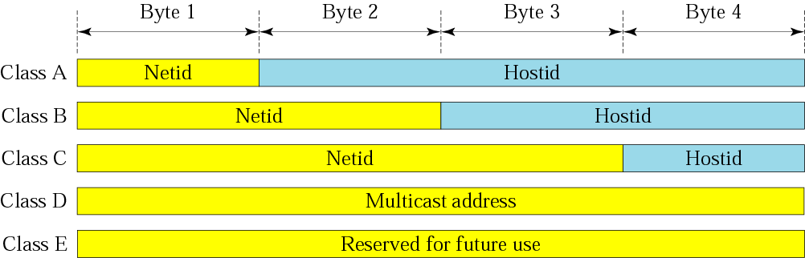
Netid and hostid

Slide 25
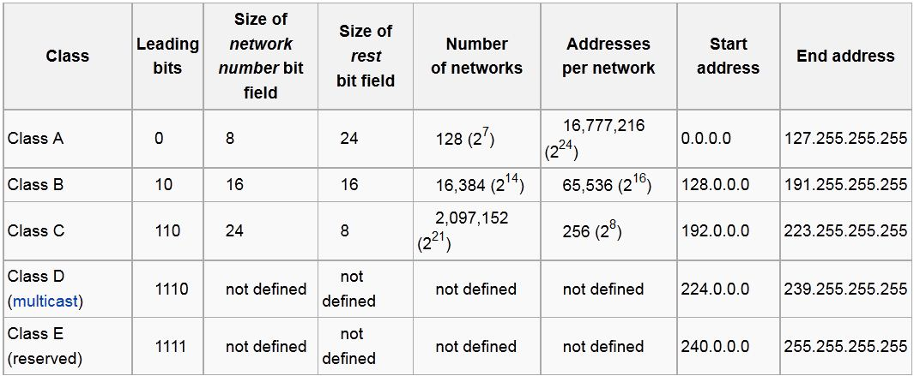

Slide 26
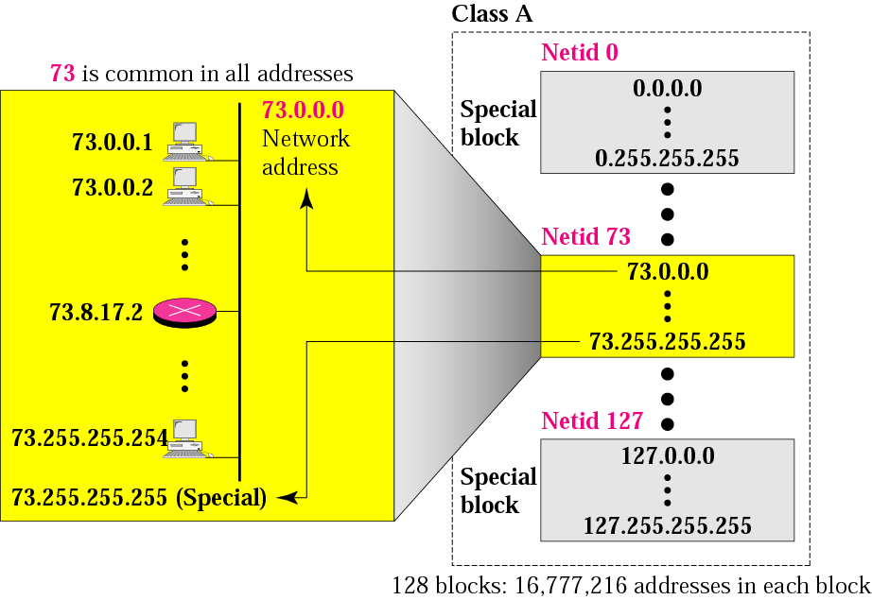
Blocks in class A

Slide 27
Millions of class A addresses
are wasted.

Slide 28
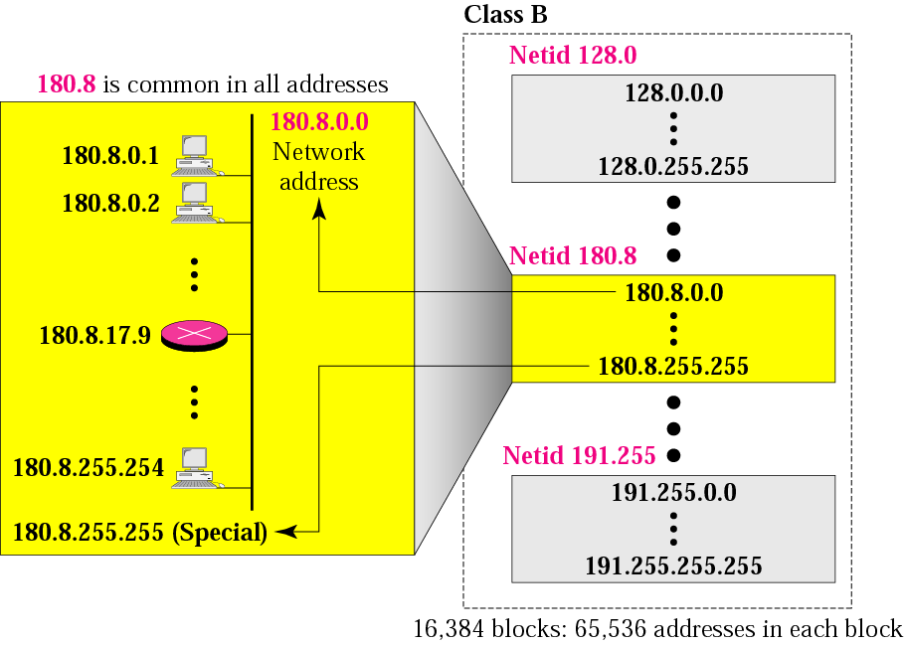
Blocks in class B

Slide 29
Many class B addresses
are wasted.

Slide 30
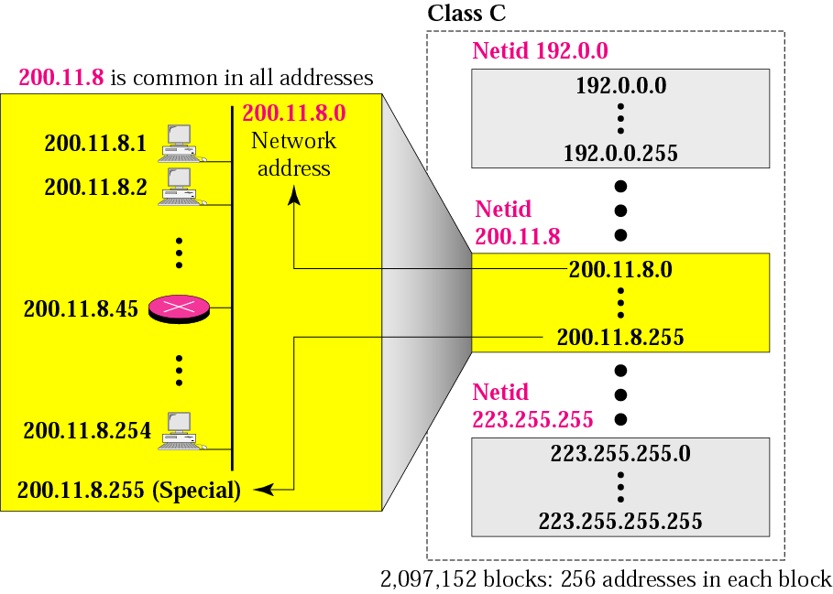
Blocks in class C

Slide 31
The number of addresses in a
class C block
is smaller than
the needs of most organizations.

Slide 32
Class D addresses
are used for multicasting;
there is only
one block in this class.

Slide 33
Class E addresses are reserved
for special purposes;
most of the block is wasted.

Slide 34
Private IP Addresses
Private IP address
  10.0.0.0/8
  172.16.0.0/12
  192.168.0.0/16

Slide 35
Special IP Addresses
Loopback IP address
  127.0.0.1 (127.0.0.0 to 127.255.255.255)
Link-local address
  169.254.0.0 /16
Default route
  0.0.0.0 - 0.255.255.255 (0.0.0.0 /8)
Notes:
Link-local address
These addresses can be automatically assigned to the local host by the operating system in environments where no IP configuration is available.
Loopback IP address
Traffic is directed to the system itself.

Slide 36
Network Address
The network address is the first address.
The network address defines the network to the rest of the Internet.
Given the network address, we can find the class of the address, the block, and the range of the addresses in the block

Slide 37
Example 9
Given the network address 17.0.0.0, find the class, and the range of the addresses.
Solution
The class is A because the first byte is between
0 and 127.
The addresses range from 17.0.0.0 to
17.255.255.255.

Slide 38
Example 10
Given the network address 132.21.0.0, find the class, and the range of the addresses.
Solution
The class is B
netid of 132.21.0.0
Addresses range from 132.21.0.0 to 132.21.255.255

Slide 39
Example 11
Given the network address 220.34.76.0, find the class, and the range of the addresses.
Solution
The class is C
netid of 220.34.76.0
The addresses range from 220.34.76.0 to 220.34.76.255

Slide 40
Mask
A mask is a 32-bit binary number that gives the first address in the block (the network address) when bitwise ANDed with an address in the block.

Slide 41
Example 12
Given the address 23.56.7.91 and the default class A mask, find the beginning address (network address).
Solution
The default mask is 255.0.0.0,
which means that only the first byte is preserved
and the other 3 bytes are set to 0s.
The network address is 23.0.0.0.

Slide 42
Example 13
Given the address 132.6.17.85 and the default class B mask, find the beginning address (network address).
Solution
The default mask is 255.255.0.0,
which means that the first 2 bytes are preserved
and the other 2 bytes are set to 0s.
The network address is 132.6.0.0.

Slide 43
Example 14
Given the address 201.180.56.5 and the class C default mask, find the beginning address (network address).
Solution
The default mask is 255.255.255.0,
which means that the first 3 bytes are preserved
and the last byte is set to 0.
The network address is 201.180.56.0.

Slide 44
Sub-netting
To reduce wastage of IP addresses in a block, sub-netting is used.
Using host bits as network bit of a class-full IP address.

Slide 45
Sub-netting
Q1. Find the network address
192.168.241.99/27
192.168.241.107/26
192.168.241.117/29
192.168.241.127/27

Slide 46
Question
You are given a class B IP address 172.16.0.0. There is a need of 7 different networks. Find out the first and last IP address of each and subnet mask for each network.

Slide 47
Solution
Given IP address is of Class B,
Default mask is /16 or 255.255.0.0
As required number of subnets are 7, to represent this we require 3 bits (2³=8)
So, number of bits required to borrow from host bits are 3.
Total bits for network are now : 16(default for class B)+3 (borrowed from host bits)=19

Slide 48
Solution… Contd.
8.8.3.0 (number of network bits in each octet)
Or, 11111111.11111111.11100000.00000000
Or, 255.255.224.0 (subnet mask)
172.16.0.0 (1st address), 172.16.0.1 (1st host)
172.16.00011111.11111110 (last host) 172.16.00011111.11111111 (last address), or,
172.16.31.255 (last address)

Slide 49
Solution… Contd.
When we find next address to broadcast that will be: 172.16.00011111.11111111
+1
--------------------------------------------------
172.16.00100000.00000000
Next subnet’s 1st address is 172.16.32.0
Last address of this subnet is 172.16.63.255

Slide 50
Subnet | 1st Address | Last Address | 1st host | Last host | Number of host
1st | 172.16.0.0 | 172.16.31.255 | 172.16.0.1 | 172.16.31.254 | 2¹³ -2
2nd | 172.16.32.0 | 172.16.63.255 | 172.16.32.1 | 172.16.63.254 | 2¹³ -2
3rd | 172.16.64.0 | 172.16.95.255 | 172.16.64.1 | 172.16.95.254 | 2¹³ -2
4th | 172.16.96.0 | 172.16.127.255 | 172.16.96.1 | 172.16.127.254 | 2¹³ -2
5th | 172.16.128.0 | 172.16.159.255 | 172.16.128.1 | 172.16.159.254 | 2¹³ -2
6th | 172.16.160.0 | 172.16.191.255 | 172.16.160.1 | 172.16.191.254 | 2¹³ -2
7th | 172.16.192.0 | 172.16.255.255 | 172.16.192.1 | 172.16.255.254 | 2¹³ -2

Slide 51
Example 1
What is the subnetwork address if the destination address is 19.30.84.5 and the mask is 255.255.192.0?

Slide 52
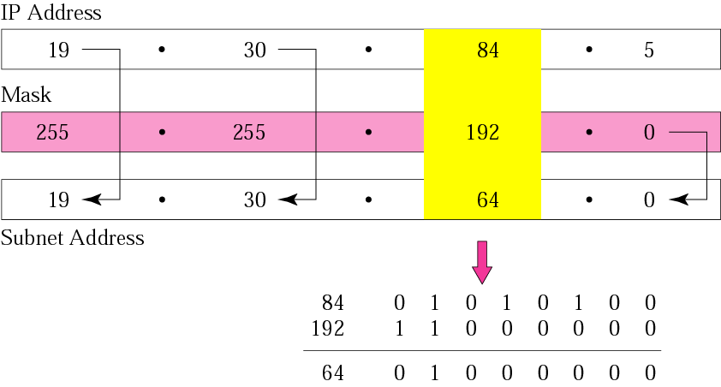
Example 1
Solution

Slide 53
Example 2
What is the subnet address if the destination address is 200.45.34.56 and the subnet mask is 255.255.240.0?

Slide 54
Solution
11001000 00101101 00100010 00111000
11111111 11111111 11110000 00000000
11001000 00101101 00100000 00000000
The subnetwork address is 200.45.32.0.

Slide 55
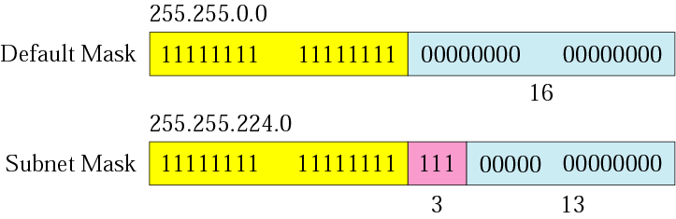
Comparison of a default mask and
a subnet mask

Slide 56

The number of subnets must be
a power of 2.

Slide 57
Example 3
A company is granted the site address 201.70.64.0 (class C). The company needs six subnets. Design the subnets.
Solution
The number of 1s in the default
mask is 24 (class C).

Slide 58
Solution (Continued)
The company needs six subnets. This number 6 is not a power of 2. The next number that is a power of 2 is 8 (2³).
We need 3 more 1s in the subnet mask. The total number of 1s in the subnet mask is 27 (24 + 3).
The total number of 0s is 5 (32 − 27). The subnet mask is therefore:

Slide 59
Solution (Continued)
11111111 11111111 11111111 11100000
or
255.255.255.224
    The number of subnets is 8.
    The number of addresses in each subnet is 2⁵ (5 is the number of 0s) or 32.
See the Figure:

Slide 60
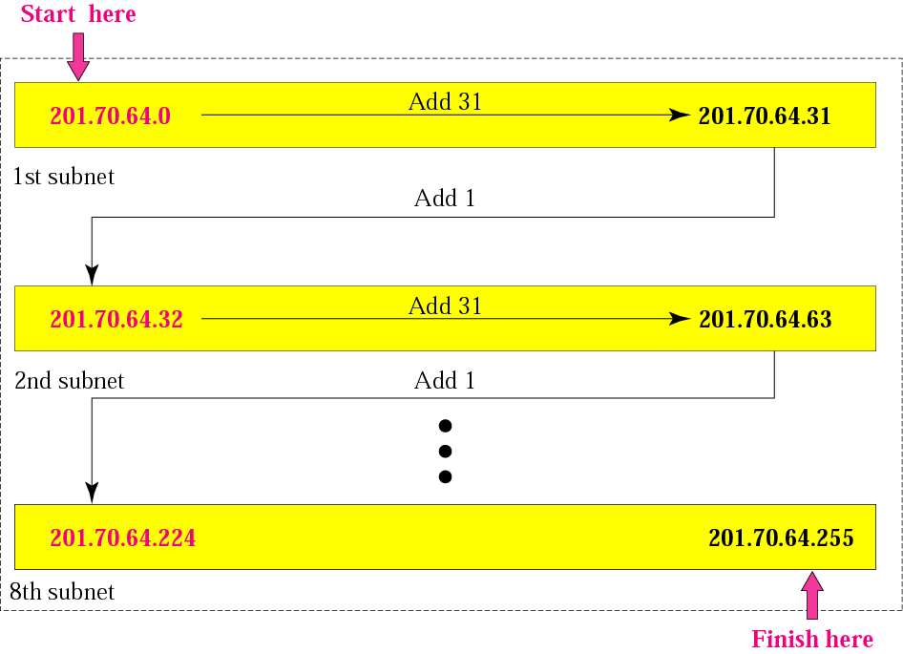
Example 3

Slide 61
Example 4
A company is granted the site address 181.56.0.0 (class B). The company needs 1000 subnets. Design the subnets.
Solution
The number of 1s in the default mask is 16 (class B).

Slide 62
Solution (Continued)
The company needs 1000 subnets. This number is not a power of 2. The next number that is a power of 2 is 1024 (2¹⁰).
We need 10 more 1s in the subnet mask.
The total number of 1s in the subnet mask is 26 (16 + 10).
The total number of 0s is 6 (32 − 26).

Slide 63
Solution (Continued)
The mask is
11111111 11111111 11111111 11000000
or
255.255.255.192.
The number of subnets is 1024.
The number of addresses in each subnet is 2⁶ (6 is the number of 0s) or 64.
See Figure:

Slide 64
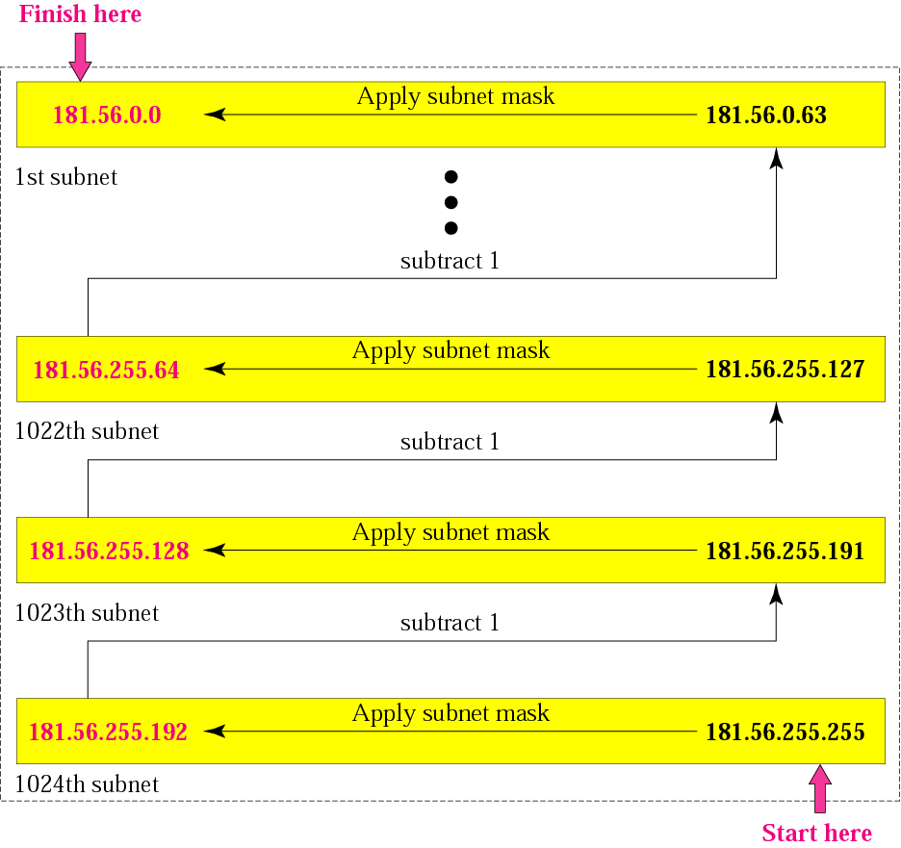
Example 4

Slide 65
CLASSLESS ADDRESSING

Slide 66
Classfull vs. Classless Addressing
Classless addressing, announced in 1996, allows an ISP to assign as few or as many IP addresses as requested
The entire 2^32 address space is divided into variable-sized blocks, which are multiples of powers of 2
TCP/IP Protocol Suite

Slide 67
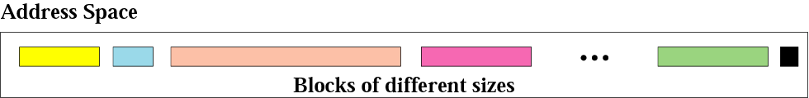
Variable-length blocks

Slide 68
Restrictions
The number of addresses in a block must be a power of 2
The first address must be evenly divisible by the number of addresses.
  For e.g., if a block contains 4 addresses, the first address must be divisible by 4.
TCP/IP Protocol Suite

Slide 69
Example 1
Which of the following can be the beginning address of a block that contains 16 addresses?
a. 205.16.37.32 b.190.16.42.44
c. 17.17.33.80 d.123.45.24.52
Solution
Only two are eligible (a and c). The address 205.16.37.32 is eligible because 32 is divisible by 16. The address 17.17.33.80 is eligible because 80 is divisible by 16.
TCP/IP Protocol Suite

Slide 70
Example 2
Which of the following can be the beginning address of a block that contains 256 addresses?
a.205.16.37.32 b.190.16.42.0
c.17.17.32.0 d.123.45.24.52
TCP/IP Protocol Suite

Slide 71
Example 2
Which of the following can be the beginning address of a block that contains 256 addresses?
a.205.16.37.32 b.190.16.42.0
c.17.17.32.0 d.123.45.24.52
Solution
In this case, the right-most byte must be 0. As we mentioned in Chapter 4, the IP addresses use base 256 arithmetic. When the right-most byte is 0, the total address is divisible by 256. Only two addresses are eligible (b and c).
TCP/IP Protocol Suite

Slide 72
Example 3
Which of the following can be the beginning address of a block that contains 1024 addresses?
a. 205.16.37.32 b.190.16.42.0
c. 17.17.32.0 d.123.45.24.52
TCP/IP Protocol Suite

Slide 73
Example 3
Which of the following can be the beginning address of a block that contains 1024 addresses?
a. 205.16.37.32 b.190.16.42.0
c. 17.17.32.0 d.123.45.24.52
Solution
In this case, we need to check two bytes because
1024 = 4 × 256. The right-most byte must be divisible by 256. The second byte (from the right) must be divisible by 4. Only one address is eligible (c).
TCP/IP Protocol Suite

Slide 74
Masks
In classfull addressing, the mask for each block is implicit (Default mask)
  255.0.0.0/8
  255.255.0.0/16
  255.255.255.0/24
In classless addressing, we need the address and the mask to find the block the address belongs to.
TCP/IP Protocol Suite

Slide 75
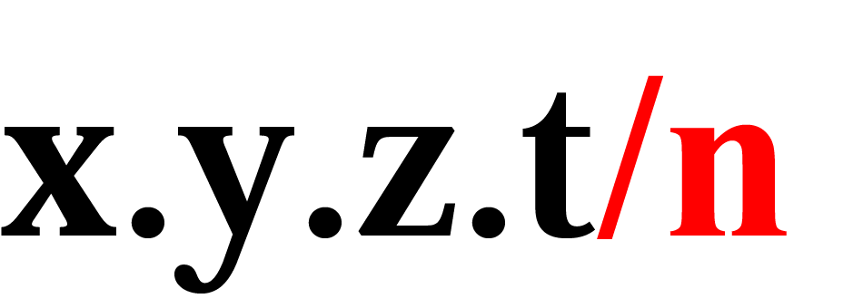
Slash notation
An address in classless addressing usually has this format:
The n after the slash defines the number of bits that are the same in every address in the block
So if n is 20, it means the twenty leftmost bits are identical in each address.

Slide 76
Slash notation is also called
CIDR (Classless Inter Domain Routing)
notation.

Slide 77
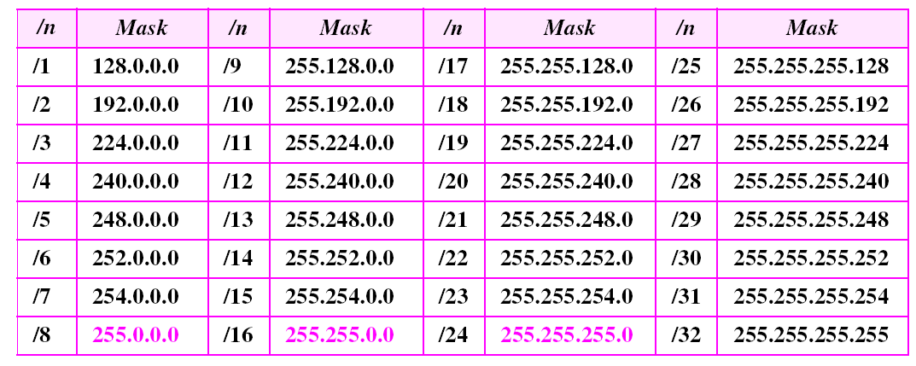
Table 5.1 Prefix lengths
The addresses in color are the default masks for classes A, B, and C.
Thus, classful addressing is a special case of classless addressing.
TCP/IP Protocol Suite

Slide 78
Example 4 - Find first address
What is the first address in the block if one of the addresses is 167.199.170.82/27?
TCP/IP Protocol Suite

Slide 79
Example 4 - Find first address
What is the first address in the block if one of the addresses is 167.199.170.82/27?
Solution
The prefix length is 27, which means that we must keep the first 27 bits as is and change the remaining bits (5) to 0s. The following shows the process:
Address in binary: 10100111 11000111 10101010 01010010
Keep the left 27 bits: 10100111 11000111 10101010 01000000
Result in CIDR notation: 167.199.170.64/27
TCP/IP Protocol Suite

Slide 80
Example 5 – Find first address Using binary
What is the first address in the block if one of the addresses is 140.120.84.24/20?
TCP/IP Protocol Suite

Slide 81
Example 5 – Find first address Using binary
What is the first address in the block if one of the addresses is 140.120.84.24/20?
Solution
Figure 5.3 shows the solution. The first, second, and fourth bytes are easy; for the third byte we keep the bits corresponding to the number of 1s in that group. The first address is 140.120.80.0/20.
See Next Slide
TCP/IP Protocol Suite

Slide 82
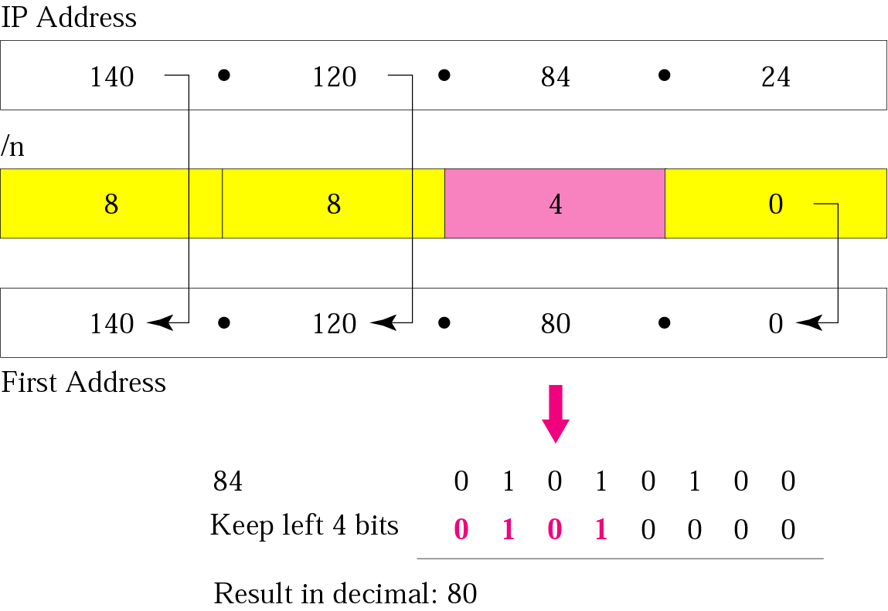
Figure 5.3 Example 5
TCP/IP Protocol Suite

Slide 83
Example 6 – Find first address Another solution method
Find the first address in the block if one of the addresses is 140.120.84.24/20.
TCP/IP Protocol Suite

Slide 84
Example 6 – Find first address Another solution method
Find the first address in the block if one of the addresses is 140.120.84.24/20.
Solution
The first, second, and fourth bytes are as defined in the previous example. To find the third byte, we write 84 as the sum of powers of 2 and select only the leftmost 4 (m is 4) as shown in Figure 5.4. The first address is 140.120.80.0/20.
See Next Slide
TCP/IP Protocol Suite

Slide 85
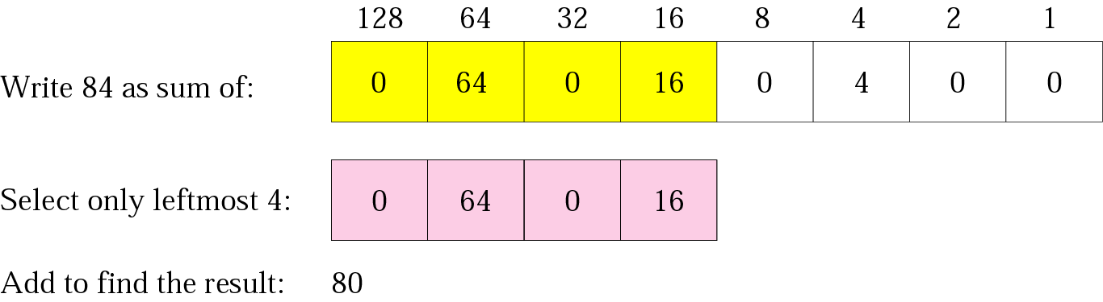
Figure 5.4 Example 6
TCP/IP Protocol Suite

Slide 86
Example 7 - Number of addresses
Find the number of addresses in the block if one of the addresses is 140.120.84.24/20.
TCP/IP Protocol Suite

Slide 87
Example 7 - Number of addresses
Find the number of addresses in the block if one of the addresses is 140.120.84.24/20.
Solution
The prefix length is 20. The number of addresses in the block is 2³²⁻²⁰ or 2¹² or 4096. Note that
this is a large block with 4096 addresses.
TCP/IP Protocol Suite

Slide 88
Example 8 - Find last address
Find the last address in the block if one of the addresses is 140.120.84.24/20.
TCP/IP Protocol Suite

Slide 89
Example 8 - Find last address
Find the last address in the block if one of the addresses is 140.120.84.24/20.
Solution
We found in the previous examples that the first address is 140.120.80.0/20 and the number of addresses is 4096. To find the last address, we need to add 4095 (4096 − 1) to the first address.
See Next Slide
TCP/IP Protocol Suite

Slide 90
Example 8 (Continued)
To keep the format in dotted-decimal notation, we need to represent 4095 in base 256 (see Appendix B) and do the calculation in base 256. We write 4095 as 15.255. (256 divides into 4095 15 times with a remainder of 255.) We then add the first address to this number (in base 255) to obtain the last address as shown below:
140 . 120 . 80 . 0
15 . 255
-------------------------
140 . 120 . 95 . 255
The last address is 140.120.95.255/20.
TCP/IP Protocol Suite

Slide 91
Alternate Method
Not comfortable about base 256 arithmetic? Do it in binary.
.80.0 in binary is 01010000.00000000
4095 in binary is 1111 11111111
Add the two values:
  01011111.11111111
  This is .95.255
TCP/IP Protocol Suite

Slide 92
Example 9 - find last address
Another method
Find the last address in the block if one of the addresses is 140.120.84.24/20.
TCP/IP Protocol Suite

Slide 93
Example 9 - find last address
Another method
Find the last address in the block if one of the addresses is 140.120.84.24/20.
Solution
The mask has twenty 1s and twelve 0s. The complement of the mask has twenty 0s and twelve 1s. In other words, the mask complement is
00000000 00000000 00001111 11111111
or 0.0.15.255. We add the mask complement to the beginning address to find the last address.
See Next Slide
TCP/IP Protocol Suite

Slide 94
Example 9 (Continued)
We add the mask complement to the beginning address to find the last address.
140 . 120 . 80 . 0
0 . 0 . 15 . 255
----------------------------
140 . 120 . 95 . 255
The last address is 140.120.95.255/20.
TCP/IP Protocol Suite

Slide 95
Example 10 - find the block
Find the block if one of the addresses is 190.87.140.202/29.
TCP/IP Protocol Suite

Slide 96
Example 10 - find the block
Find the block if one of the addresses is 190.87.140.202/29.
Solution
We follow the procedure in the previous examples to find the first address, the number of addresses, and the last address. To find the first address, we notice that the mask (/29) has five 1s in the last byte. So we write the last byte as powers of 2 and retain only the leftmost five as shown below:
See Next Slide
TCP/IP Protocol Suite

Slide 97
Example 10 (Continued)
202 ➡ 128 + 64 + 0 + 0 + 8 + 0 + 2 + 0
The leftmost 5 numbers are ➡ 128 + 64 + 0 + 0 + 8
The first address is 190.87.140.200/29
The number of addresses is 2³²⁻²⁹ or 8. To find the last address, we use the complement of the mask. The mask has twenty-nine 1s; the complement has three 1s. The complement is 0.0.0.7.
If we add this to the first address, we get 190.87.140.207/29. In other words, the first address is 190.87.140.200/29, the last address is 190.87.140.207/20. There are only 8 addresses in this block.
TCP/IP Protocol Suite

Slide 98

Note:
In classless addressing, the last address in the block does not necessarily end in 255.
TCP/IP Protocol Suite

Slide 99
Note:
In CIDR (Classless InterDomain Routing) notation, the block granted is defined by the first address and the prefix length.
TCP/IP Protocol Suite

Slide 100
Example 11
A small organization is given a block with the beginning address and the prefix length 205.16.37.24/29 (in slash notation). What is the range of the block?
Solution
The beginning address is 205.16.37.24. To find the last address we keep the first 29 bits and change the last 3 bits to 1s.
Beginning:11001111 00010000 00100101 00011000
Ending : 11001111 00010000 00100101 00011111
There are only 8 addresses in this block.

Slide 101
Example 12
We can find the range of addresses in Example 11 by another method. We can argue that the length of the suffix is 32 − 29 or 3. So there are 2³ = 8 addresses in this block. If the first address is 205.16.37.24, the last address is 205.16.37.31 (24 + 7 = 31).

Slide 102
A block in classes A, B, and C
can easily be represented in slash
notation as
A.B.C.D/ n
where n is
either 8 (class A), 16 (class B), or
24 (class C).

Slide 103
Example 13
What is the network address if one of the addresses is 167.199.170.82/27?
Solution
The prefix length is 27, which means that we must keep the first 27 bits as it is and change the remaining bits (5) to 0s. The 5 bits affect only the last byte. The last byte is 01010010. Changing the last 5 bits to 0s, we get 01000000 or 64. The network address is 167.199.170.64/27.

Slide 104
Example 14
An organization is granted the block 130.34.12.64/26. The organization needs to have four subnets. What are the subnet addresses and the range of addresses for each subnet?
Solution
The suffix length is 6. This means the total number of addresses in the block is 64 (2⁶). If we create four subnets, each subnet will have 16 addresses.

Slide 105
Solution (Continued)
Let us first find the subnet prefix (subnet mask). We need four subnets, which means we need to add two more 1s to the site prefix. The subnet prefix is then /28.
Subnet 1: 130.34.12.64/28 to 130.34.12.79/28.
Subnet 2 : 130.34.12.80/28 to 130.34.12.95/28.
Subnet 3: 130.34.12.96/28 to 130.34.12.111/28.
Subnet 4: 130.34.12.112/28 to 130.34.12.127/28.
See Figure 5.15 on next slide

Slide 106
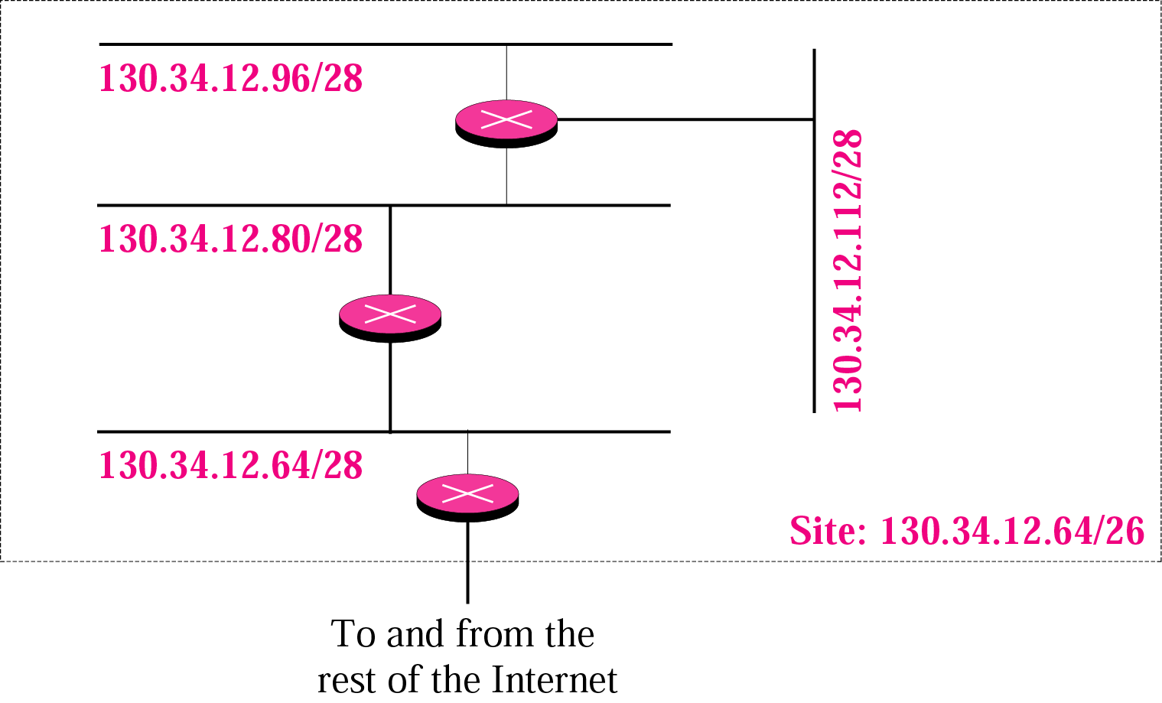
Figure 5-15
Example 14

Slide 107
Example 15
An ISP is granted a block of addresses starting with 190.100.0.0/16. The ISP needs to distribute these addresses to three groups of customers as follows:
1. The first group has 64 customers; each needs 256 addresses.
2. The second group has 128 customers; each needs 128 addresses.
3. The third group has 128 customers; each needs 64 addresses.
Design the sub-blocks and give the slash notation for each sub-block.

Slide 108
Solution
Group 1
For this group, each customer needs 256 addresses. This means the suffix length is 8 (2⁸ = 256). The prefix length is then 32 − 8 = 24.
Customer1: 190.100.0.0/24 ➔190.100.0.255/24
Customer2: 190.100.1.0/24 ➔190.100.1.255/24
…………………………………..
Customer64: 190.100.63.0/24 ➔190.100.63.255/24
Total = 64 × 256 = 16,384

Slide 109
Solution (Continued)
Group 2
For this group, each customer needs 128 addresses. This means the suffix length is 7 (2⁷ = 128). The prefix length is then 32 − 7 = 25. The addresses are:
Customer1: 190.100.64.0/25 ➔190.100.64.127/25
Customer2: 190.100.64.128/25 ➔190.100.64.255/25
…
…
Customer128: 190.100.127.128/25 ➔190.100.127.255/25
Total = 128 × 128 = 16,384

Slide 110
Solution (Continued)
Group 3
For this group, each customer needs 64 addresses. This means the suffix length is 6 (2⁶ = 64). The prefix length is then 32 − 6 = 26. The addresses are:
Cust1: 190.100.128.0/26 ➔190.100.128.63/26
Cust2: 190.100.128.64/26 ➔190.100.128.127/26
…
…
Cust128: 190.100.159.192/26 ➔190.100.159.255/26
Total = 128 × 64 = 8,192

Slide 111
Private Addresses
A number of blocks in each class are assigned for private use. They are not recognized globally. These blocks are depicted as follows:
Class A: 10.0.0(Net id) and no of Blocks is 1
Class B: 172.16-172.31 and 16
Class C: 192.168.0-192.168.255 and 256 blocks

Slide 112
Supernetting
Network
Network
Network
Subnet
16 8 4 2 1
172.16.12.0
11000000
10101000
00001100
00000000
172.16.13.0
11000000
10101000
00001101
00000000
172.16.14.0
11000000
10101000
00001110
00000000
172.16.15.0
11000000
10101000
00001111
00000000
255.255.255.0
11111111
11111111
11111111
00000000

Slide 113
Supernetting
Network
Network
Network
Subnet
16 8 4 2 1
172.16.12.0
11000000
10101000
00001100
00000000
172.16.13.0
11000000
10101000
00001101
00000000
172.16.14.0
11000000
10101000
00001110
00000000
172.16.15.0
11000000
10101000
00001111
00000000
255.255.252.0
11111111
11111111
11111100
00000000
172.16.12.0/24
172.16.13.0/24
172.16.14.0/24
172.16.15.0/24
172.16.12.0/22

Slide 114
Supernetting
Assign an organization a block of plentiful addresses (class C) rather than a single scarce (class B) address
Example:
  An organization wants to connect to the Internet
  The organization would prefer a class B address
    Plans to subnet its various physical networks using the third octet of the IP address to represent the subnet
      This would allow the organization to have 254 physical networks with up to 254 hosts per network

Slide 115
Supernetting (cont)
Example (cont):
  Instead of getting a class B address, the organization is given 256 contiguous class C addresses
    E.g. 192.17.0.0 – 192.17.255.0
  Then:
    The organization can have up to 256 physical networks (each with its own class C network address)
    Each physical network can have up to 254 hosts
Result: a block of plentiful addresses (class C) substituted for a single scarce (class B) address

Slide 116

Supernetting Question
172.1.4.128/25
172.1.4.128/25
172.1.5.0/24
R1
R2
172.1.6.0/24
172.1.7.0/24
What is the most efficient summarization that TK1 can use to advertise its networks to TK2?
  A. 172.1.4.0/24172.1.5.0/24172.1.6.0/24172.1.7.0/24
  B. 172.1.0.0/22
  C. 172.1.4.0/25172.1.4.128/25172.1.5.0/24172.1.6.0/24172.1.7.0/24
  D. 172.1.0.0/21
  E. 172.1.4.0/22

